Slide 1
Hur kan vi utveckla teknisk kompetens i Norden?
Lena Gumaelius
Lektor och docent på KTH
Prorektor för Mälardalens Högskola

Slide 2
WHY?
The overarching goal is to create a platform for knowhow sharing, a nexus for generation and dissemination of new ideas on STEM education.
KTH, Aalto University, Aalborg University, Reykjavik University, Stavanger University, NORDTEK, ANE

Slide 3
Målsättning med NordEn Hub är att:
Stimulera utvecklingen av ingenjörsutbildning i Norden
Fungera som en expertkälla för politiker och beslutsfattare
Etablera ett nätverk för intressenter av ingenjörsutbildning
Öka medvetenheten och attraktionskraften för STEM-utbildning i hela utbildningskedjan
Erbjuda en plattform för projekt inom STEM
Notes:
Based on the outcomes of a conducted comparative analysis of the various educational practices, to propose solutions to close the exiting gaps and to modernise the entire education chain from school level to higher education, including continuous education.
With reference to the results of the conducted research, to provide advice and form recommendations for policy interventions and support.
Through the creation of inter-sectorial networks as discussion- and anchoring- base for participants from engineering institutions, academia, business and public sector.
By establishing a database that aims at describing and comparing the educational environments in the Nordic countries. In addition, by identifying best practices in raising interest for STEM among the young generation as well as providing visibility to these practices through targeted communication events.
By means of facilitating research, innovation and development applications for STEM education, as well as initiating new collaborative activities for practitioners in schools, colleges and universities.

Slide 4
Finansierat av:
Erasmus + projekt
Nordiska ministerrådet
Nordplus
Partneruniversitet

Slide 5
Subproject 1.
“Forming interest for STEM among youth”
In order to identify best-practice cases for outreach activities organized by universities, a thorough review of what has been done in each country so far has been done.
11 cases have been analysed, 4 strategies found.
awareness
competence
role modelling
play
STEM =Science, Technology, Engineering, Mathematics
Notes:
of engineering education (e.g. by promoting inclusion and fighting misconceptions),
in STEM (e.g. by teaching STEM related topics)
(e.g. with role models or peer support), and
(e.g. by assigning enjoyable hands on tasks to the participants) during the outreach activity.

Slide 6
Comparision of School systems within the Nordic Region:

Slide 7
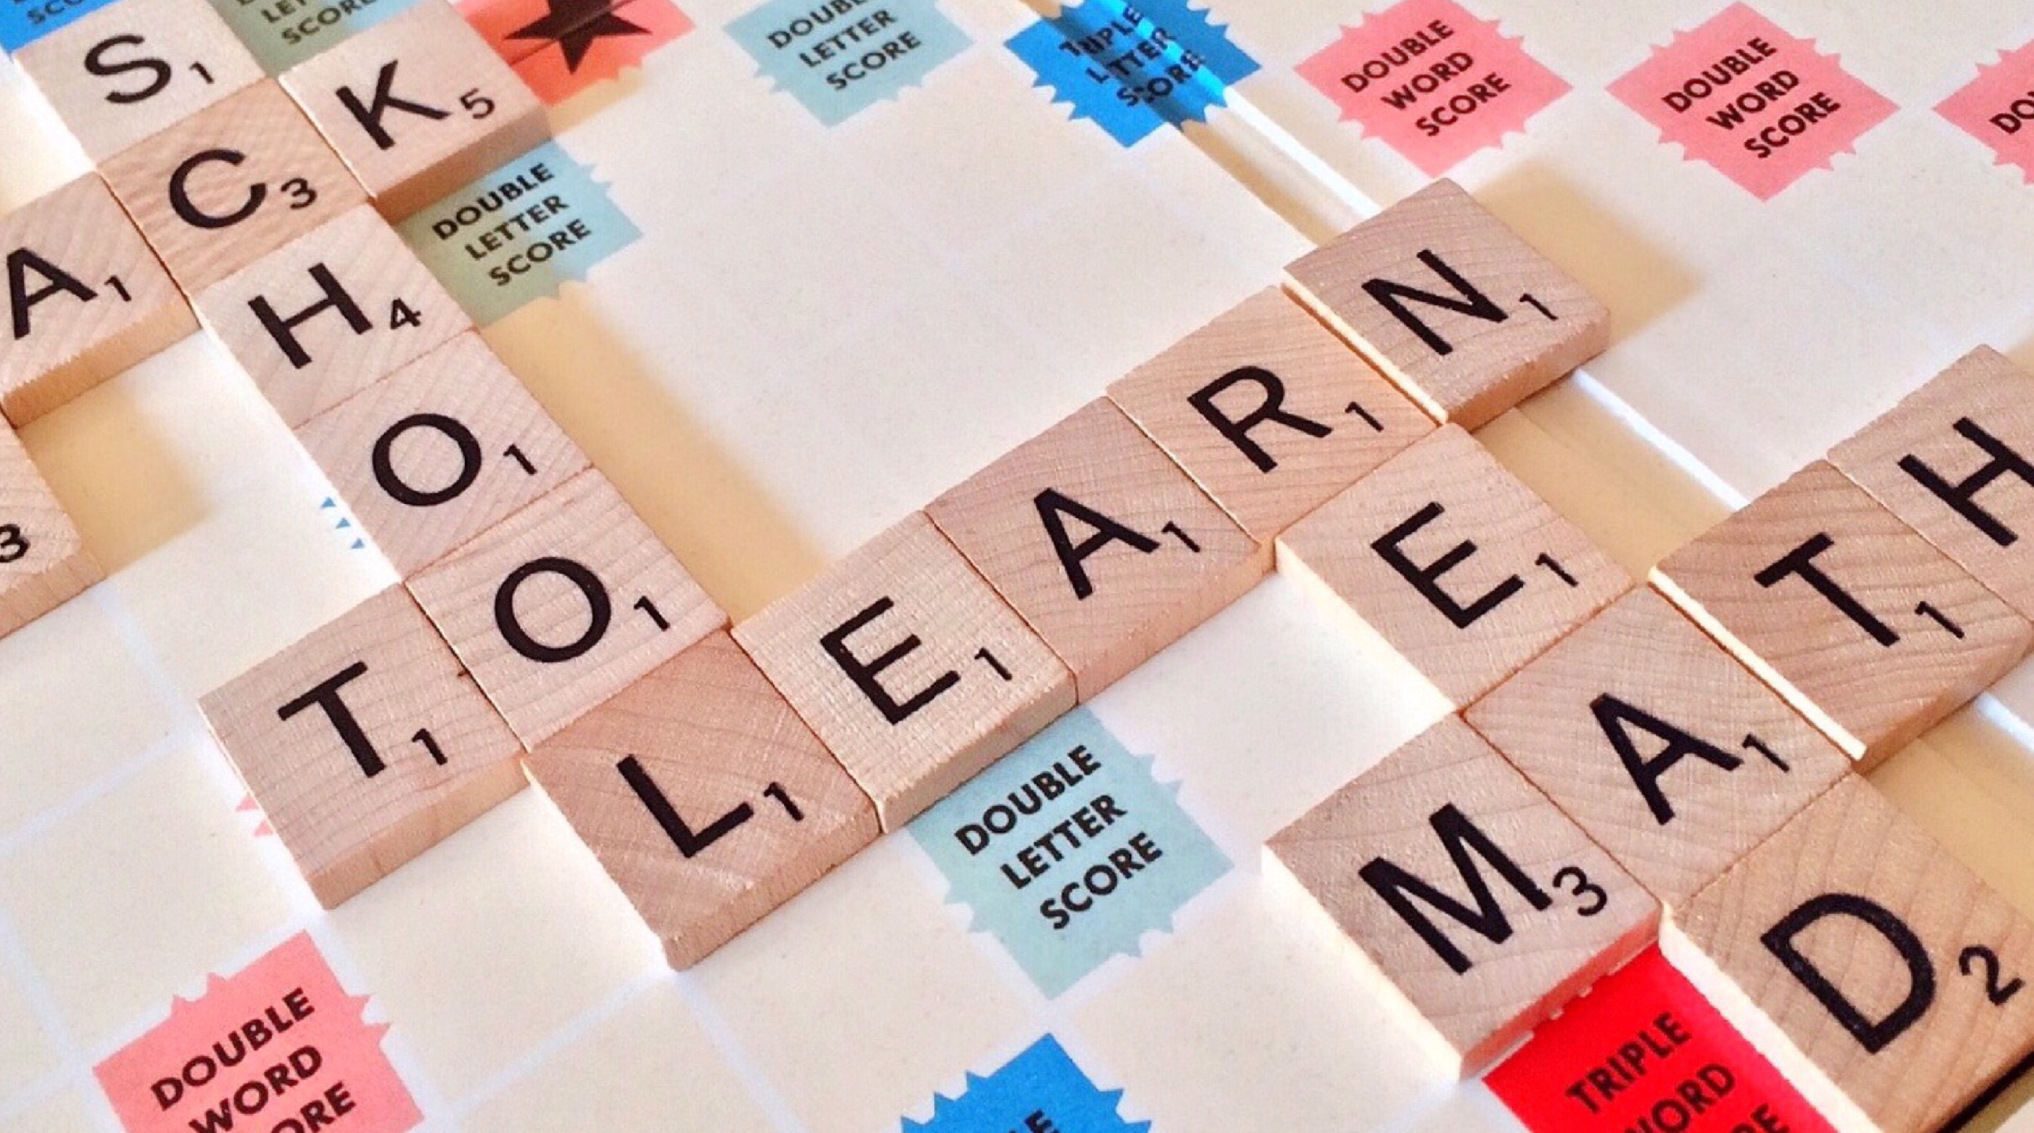
Subproject 2.
“Life long learning”
The study will aim at mapping strategies and current practices of continuing education. It has also the objective to identify trends in cross collaboration and to find new paradigms for knowledge flow between Nordic universities, industries and professional engineers.

Slide 8
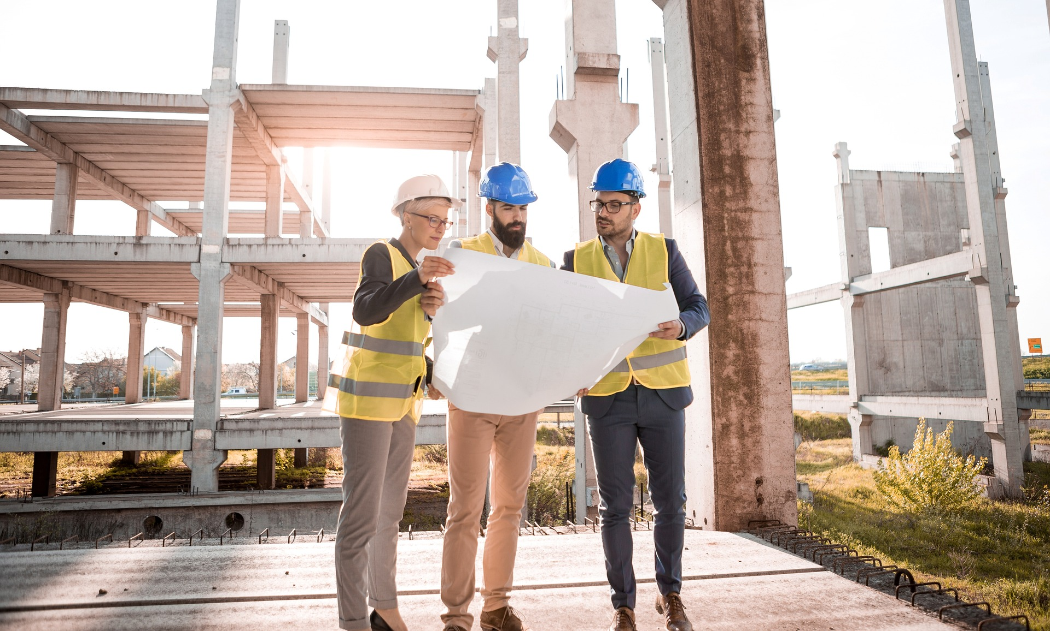
Subproject 3.
“Future Engineering education 2030”
This subproject consists of a comparative study of engineering education practices and stakeholders’ ideas of tomorrows engineering education. This study will identify which skills are viewed upon as important and how the perception of engineering education differs across Nordic countries.

Slide 9
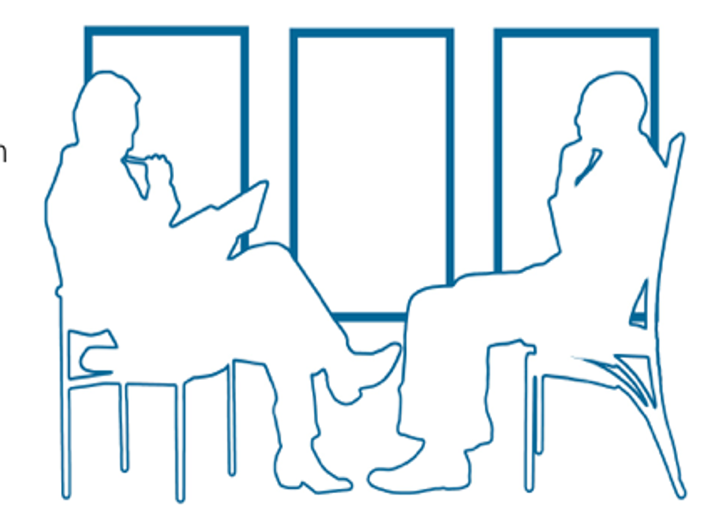
Interview of 20 professors at the partner universities
The following questions formed the basis of the interviews.
1. How do you think the challenges (sustainable development, digitalisation and employability) affect the development of your discipline and the educational programme(s) you are involved in?
2. What do you expect the situation to be 10 years from now?

Slide 10
AI
Automatization
Models and simulations
Internet of Things
Robotics
DIGITALIZATION
'Up to now, we have mostly used computers to do what we could already do manually, but faster. But now we see innovations where computers bring about brand new things' (Norway 1).
Notes:
Digitalization is everywhere, we are in the mid of it, although the change is stil ahead of us.
'Up to now, we have mostly used computers to do what we could already do manually, but faster. But now we see innovations where computers bring about brand new things' (Norway 1).

Slide 11
New disciplines formed due to digitalization:
Bioinformatics, Mechatronics
Distribution of knowledge:
Software used in industry needs to be practiced in courses
Modelling and simulations important tools
The focus on robotization demand better competence in programming within most engineering fields
ACTORS affecting development:
Society
Industry
Who will teach?
PhD students, other experts,
Notes:
Bioinformatics and mechatronics have been there for long, have changed education, now, you learn the basic stuff for bioinformatics first, instead of just biliogy and maths, metadata, statistics
Mecatroings, mix of electrical and mecanics program – see the need for more courses in safety and ethics
Computer science – mixed with many disciplines in many different ways.

Slide 12
“Internet of Things or automated driving, or artificial intelligence; billion after billion has been invested and companies are looking for prospective future markets.
There's an extreme technology push for new markets. And then there's an extreme push for getting hold of the right competence”. (Swe 1)
Notes:
Tuff question:
“And that is a challenge for the supervisors because we cannot do it. None of us can handle the data. But my PhD-students can, and my post docs can do it. So, they can be coaches in the projects at all levels.” (Nor 2)
‘this is something that has been done in the discipline of computer engineering for decades, they should be able to help us others out’. (Denmark 3)

Slide 13
Discussion
Digitalization – societal change – widely accepted, obvious that industry needs engineers with digital skills, development seem to be more discipline dependent
+ production --------bio--------civil, energy--------mechanics(and chemistry, physics)-

Slide 14
Energy savings
Transportation
Energy models
Economic sustainability
Social sustainability
SUSTAINABLE DEVELOPMENT
”…it's also the 17 sustainability (goals)... I mean,... how does that create value? This we have to work (on) some more systematically in the educational programs.” (Den 4)

Slide 15
The role sustainable development plays differs a lot among the universities investigated
“…talking about sustainable development, it's clear we are in the heart of that. So, I think for what I'm doing, it's really sustainable biotechnology and so on. So, we don't really see major changes (coming up), we are in the changes…” (Den 3)
... and I think that will be more in the years to come, much more... now when you're going to construct a building, you think costs. That's the main issue. Cheapest as possible. But I think the environment and the CO2 footprint will be more significant and not only price will be the issue.” (Nor 1)
Notes:
The level of integration seemed to be more university (or country) dependent than subject specific, however it should be noted that the number of interviews were small and no statistical evidence can be given .

Slide 16
Barriers for implementing SD in educational programs:
One of the professors express it as ‘teacher get tired’ and they ‘want to be left alone’ not having to work with the centre for Sustainablility. (Fin 1)
“Today, we see a trend where focus on SD also means more general programs, something that can prevent us from training the specialist skills that are also needed for us to be able to solve the sustainability goals”. (Sweden 4)

Slide 17
Discussion
Digitalization – societal change – widely accepted, obvious that industry needs engineers with digital skills, development seem to be more discipline dependent
+ production --------bio--------civil, energy--------mechanics(and chemistry, physics)-
SD – level of integration depends upon societal pressure. Society or/and university needs to have a vision on strengthening SD, pressure from outside seem to be different in different countries
+ Denmark-----------Sweden------------Iceland-------------Finland------------Norway -

Slide 18
Expected change when it comes to education in general:
Expectation of the need of more Y or T-shaped engineers instead of only I-shaped engineers
Education more flexible, both when it comes to where, when and how
The role of the university may change – controlling/valuing experiences/knowledge rather than giving the courses

Slide 19
Expected change when it comes to pedagogical approaches:
There is a common understanding that the old fashion way using essentially lectures and tests in the end of the course is not the most efficient way of teaching
Increase in prevalence of problem based courses (PBL, CDE etc.)
Focus on interdisciplinary courses/approaches
‘I hope it increases (interdisciplinary courses). It may not be in every course ... "..." ... It may be a housing project or another, but when one thinks of heat exchanger and solar energy, then one thinks of another social sustainability, and rent setting and availability and inclusion.’ (Swe 3)
Assessment processes difficult to change

Slide 20
TACK!
Lena Gumaelius
lenagu@kth.se

Slide 21
Vad vill Anna prata om?
Om man gör om ingenjörsutbildningen, gör man också om den så att man kan attrahera flera? Ökar man inklusiviteten?
Lena kommer att svara ungefär så här:
Utvecklas definitivt nya typer av ingenjörsutbildningar – även om de gamla också finns kvar.
Jag tror att det blir mer fokus på vad syftet med utbildningen är (i stället för att det bara fokuseras på att man ska kunna matte och sedan lösa problem. Det tror jag kan locka tjejer och andra grupper som normalt inte väljer ingenjörsutbildning.
Det kommer behövas många flera med programmeringskunskaper, vända på det och säga att vi måste se till att få in en bredare grupp – hur får vi de som inte väljer ingenjörsutbildning idag att vilja programmera? – hur kan vi hjälpa ”tjejer” att tycka att det är OK att programmera? Programmeringsskolor? I skolan innan univ? I dag efter – pojkar har ett försprång som är svårt att ta ifatt.

