Slide 1
How can we develop technical skills in the Nordic region?
Lena Gumaelius
Lektor och docent på KTH
Prorektor för Mälardalens Högskola

Slide 2
WHY?
The overarching goal is to create a platform for knowhow sharing, a nexus for generation and dissemination of new ideas on STEM education.
KTH, Aalto University, Aalborg University, Reykjavik University, Stavanger University, NORDTEK, ANE

Slide 3
The aim of NordEn Hub is to:
Stimulate the development of engineering education in the Nordic region
Act as a source of expertise for politicians and policy makers
Establish a network of stakeholders in engineering education
Raise awareness and attractiveness of STEM education throughout the education chain
Provide a platform for STEM projects
Notes:
Based on the outcomes of a conducted comparative analysis of the various educational practices, to propose solutions to close the exiting gaps and to modernise the entire education chain from school level to higher education, including continuous education.
With reference to the results of the conducted research, to provide advice and form recommendations for policy interventions and support.
Through the creation of inter-sectorial networks as discussion- and anchoring- base for participants from engineering institutions, academia, business and public sector.
By establishing a database that aims at describing and comparing the educational environments in the Nordic countries. In addition, by identifying best practices in raising interest for STEM among the young generation as well as providing visibility to these practices through targeted communication events.
By means of facilitating research, innovation and development applications for STEM education, as well as initiating new collaborative activities for practitioners in schools, colleges and universities.

Slide 4
Finansierat av:
Nordiska ministerrådet
Nordplus
Partneruniversiteten
Erasmus +

Slide 5
Mapping prerequisites for Engineering education
In order to work effectively across borders, the project has mapped the education systems in the different Nordic countries, including the Baltic States.
Universities offering engineering education are also named in this mapping report.
Available at: www.nordenhub.org

Slide 6
Comparision of School systems within the Nordic Region:
Notes:
This is an example from the report/webpage available at Nordenhub.org. This is something we want to take to the NEE webpage and our intention is to update this page continuously.

Slide 7
Forming interest for STEM among youth
In order to identify best-practice cases for outreach activities organized by universities, a thorough review of what has been done in each country so far has been done.
11 cases have been analysed, 4 strategies found.
awareness
competence
role modelling
play
STEM =Science, Technology, Engineering, Mathematics
Notes:
of engineering education (e.g. by promoting inclusion and fighting misconceptions),
in STEM (e.g. by teaching STEM related topics)
(e.g. with role models or peer support), and
(e.g. by assigning enjoyable hands on tasks to the participants) during the outreach activity.

Slide 8
Five videos presents advises to someone who wants to develop initiatives for attracting adolescents to STEM:
https://drive.google.com/drive/folders/1l1iv51AFr1u09IGcjEpss7hDzYEY5OIG

Slide 9
Life long learning
The study aimed at mapping strategies and current practices of continuing education. In addition, the objective was to identify trends in cross collaboration and to find new paradigms for knowledge flow between Nordic universities, industries and professional engineers.

Slide 10
Short presentation of: Results from the explorative interviews of 10 universities regarding continuous training
There are typically two possible organizations for CE at Nordic universities. Which is either a university internal unit or external units, such as holding companies.
There is a notable difference in whether strategies for CE have been drawn up at the various universities.
some respondents say that competences and CE are really on the political agenda. But that there must be developed a new model – also for whom to pay.
There is a general consensus that there is a need and demand for continuing education from universities.
Notes:
Universities organised in internal units mostly organize ‘Open University’ programs defined by activities that provide ECTS credits. These activities range from offering an ‘empty seat’ in ordinary education to a professional master’s programme. The Internal units most often meet a need for individual enrolment.
The extern unites also offer the above mentioned ‘Open University’ activities but besides they are highly involved in organising commercial or no credits activities. At one of the interviewed universities continuing education was organised with a decentralized structure at faculties and departments level. The university has only very few activities most often activities related to or are a direct part of their ordinary education.
Some interviewees expressed uncertainty as to whether such strategies exist – if their university has an explicit strategy for continuing education. Other universities have more or less explicit strategies but e.g. a respondent replied that 10 – 12 years ago the government decided to really push CE, which had an impact on universities.

Slide 11
Future Engineering education 2030
This subproject consists of a comparative study of engineering education practices and stakeholders’ ideas of tomorrows engineering education.

Slide 12
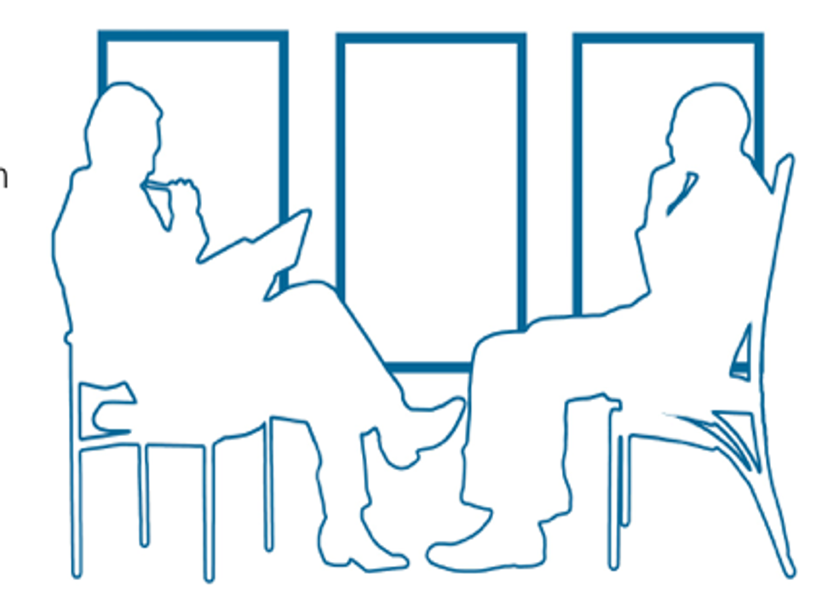
Interviews with 20 professors from 5 Nordic universities

Slide 13
'Up to now, we have mostly used computers to do what we could already do manually, but faster. But now we see innovations where computers bring about brand new things' (Norway 1).
Digitalisation
New disciplines formed due to digitalization that may be even more popular:
Bioinformatics, Mechatronics
Distribution of digitalisation knowledge:
Software used in industry needs to be practiced in courses
Modelling and simulations important tools
The focus on robotization demand better competence in programming within most engineering fields
ACTORS affecting development of education:
Society
Industry
Who will teach?
PhD students, other experts, not the professors(?)
Notes:
Bioinformatics and mechatronics have been there for long, have changed education, now, you learn the basic stuff for bioinformatics first, instead of just biliogy and maths, metadata, statistics
Mecatroings, mix of electrical and mecanics program – see the need for more courses in safety and ethics
Computer science – mixed with many disciplines in many different ways.

Slide 14
“Internet of Things or automated driving, or artificial intelligence; billion after billion has been invested and companies are looking for prospective future markets.
There's an extreme technology push for new markets. And then there's an extreme push for getting hold of the right competence”. (Swe 1)
Notes:
Tuff question:
“And that is a challenge for the supervisors because we cannot do it. None of us can handle the data. But my PhD-students can, and my post docs can do it. So, they can be coaches in the projects at all levels.” (Nor 2)
‘this is something that has been done in the discipline of computer engineering for decades, they should be able to help us others out’. (Denmark 3)

Slide 15
The role sustainable development plays differs a lot among the universities investigated
”…it's also the 17 sustainability (goals)... I mean,... how does that create value? This we have to work (on) some more systematically in the educational programs.” (Den 4)
“…talking about sustainable development, it's clear we are in the heart of that. So, I think for what I'm doing, it's really sustainable biotechnology and so on. So, we don't really see major changes (coming up), we are in the changes…” (Den 3)
... and I think that will be more in the years to come, much more... now when you're going to construct a building, you think costs. That's the main issue. Cheapest as possible. But I think the environment and the CO2 footprint will be more significant and not only price will be the issue.” (Nor 1)
Notes:
The level of integration seemed to be more university (or country) dependent than subject specific, however it should be noted that the number of interviews were small and no statistical evidence can be given .

Slide 16
Barriers for implementing SD in educational programs:
One of the professors express it as ‘teacher get tired’ and they ‘want to be left alone’ not having to work with the centre for Sustainablility. (Fin 1)
“Today, we see a trend where focus on SD also means more general programs, something that can prevent us from training the specialist skills that are also needed for us to be able to solve the sustainability goals”. (Sweden 4)

Slide 17
Expected change when it comes to education in general:
Expectation of the need of more Y or T-shaped engineers instead of only I-shaped engineers
Education is expected to be more flexible, both when it comes to where, when and how
The role of the university may change – controlling/valuing experiences/knowledge rather than giving the courses

Slide 18
Expected change when it comes to pedagogical approaches:
There is a common understanding that the old fashion way using essentially lectures and tests in the end of the course is not the most efficient way of teaching
Increase in prevalence of problem based courses (PBL, CDE etc.)
Focus on interdisciplinary courses/approaches
‘I hope it increases (interdisciplinary courses). It may not be in every course ... "..." ... It may be a housing project or another, but when one thinks of heat exchanger and solar energy, then one thinks of another social sustainability, and rent setting and availability and inclusion.’ (Swe 3)

Slide 19
Interviews of 8 managers from ten different cooperation's

Slide 20
Short presentation of: Results from the interviews with 10 corporation's
Sustainability is very important for the stakeholders. More specifically, they need competence in life cycle analysis, climate change, and low carbon solutions.
Digitalisation/Industry 4.0: all stakeholders consider digitalisation as important. Some of them see digitalisation primarily as a tool or enabler for sustainability.
The stakeholders need competence in, for example, software, cyber security, AI, cloud technology, big data, digital twins, and robotics. They also have a need for digital skills in general and, therefore, they suggest aiming for stronger integration of digitalisation and digital tools into all engineering programmes.
Other competence needs include commercialization, future business models, and teamwork skills. Moreover, the stakeholders ask for students with a holistic understanding, broader perspectives, and an understanding of how things are connected.
Notes:
The stakeholders also ask for a new type of attitude or mindset regarding sustainability, for example regarding the need to save energy.
social, environmental and economic sustainability).

Slide 21
Suggestions for future engineering education:
Sustainability and digitalisation should be included in all engineering programmes.
Less silo-thinking and more collaboration across programmes in engineering education to achieve a holistic understanding.
The students need to work in teams in projects and they need to learn to work together.
The students need to develop as human beings and consequently, the stakeholders recommend to continue with physical meetings where students work together. The stakeholders do not consider digital meetings to be sufficient to fulfil this need.

Slide 22
Thanks!
Lena Gumaelius
Lena.gumaelius@mdu.se

